Slide 1

Kicad 6
Gert Lauritsen

Slide 2



Dagsorden
Gennemgang / demoproject
Komponent søgning
BOM
PCB Panelization

Slide 3
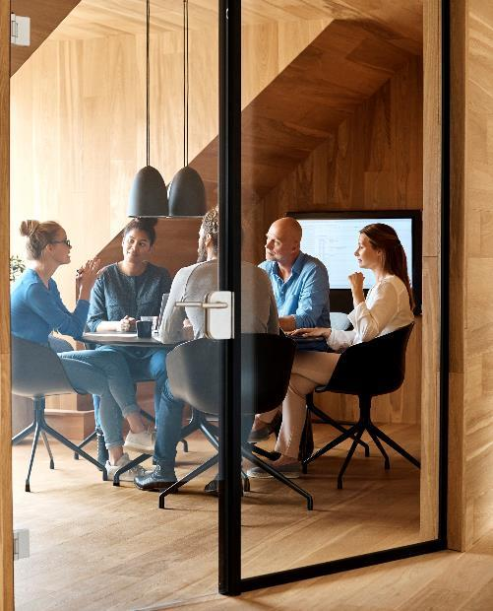



Introduktion
.

Slide 4

Kicad
The road that we take is lost in the flood

Slide 5
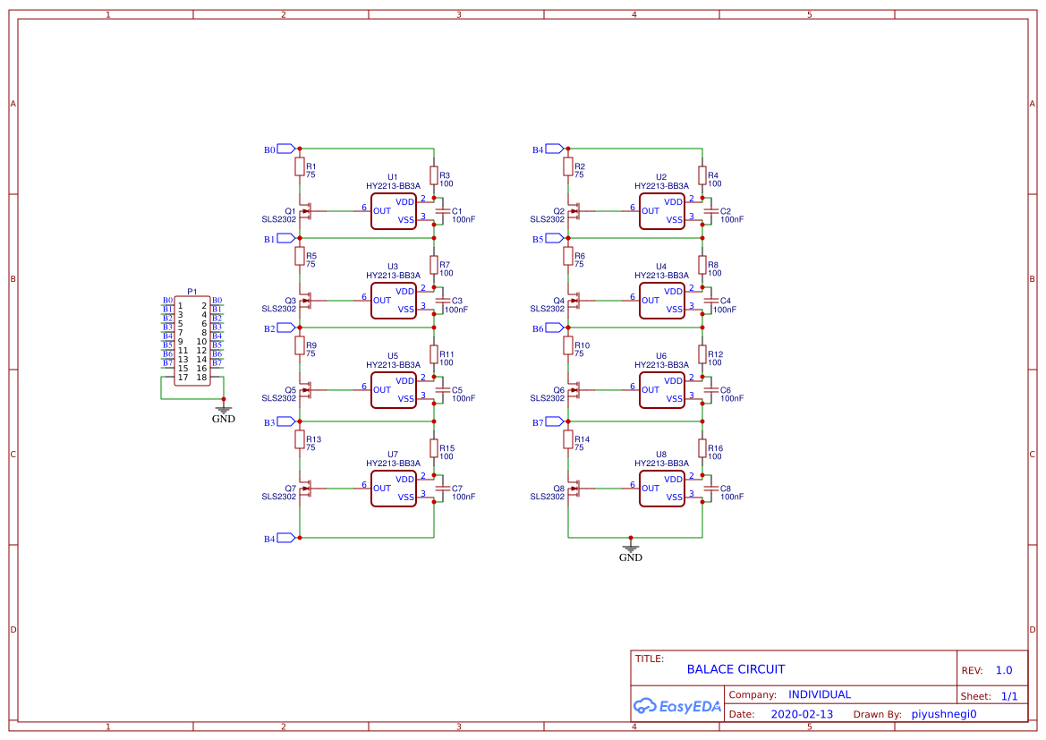
Opgave 1

Slide 6
SnapEda
The road that we take is lost in the flood

Slide 7
Library Loader
https://ms.componentsearchengine.com/pcb-libraries.php

Slide 8
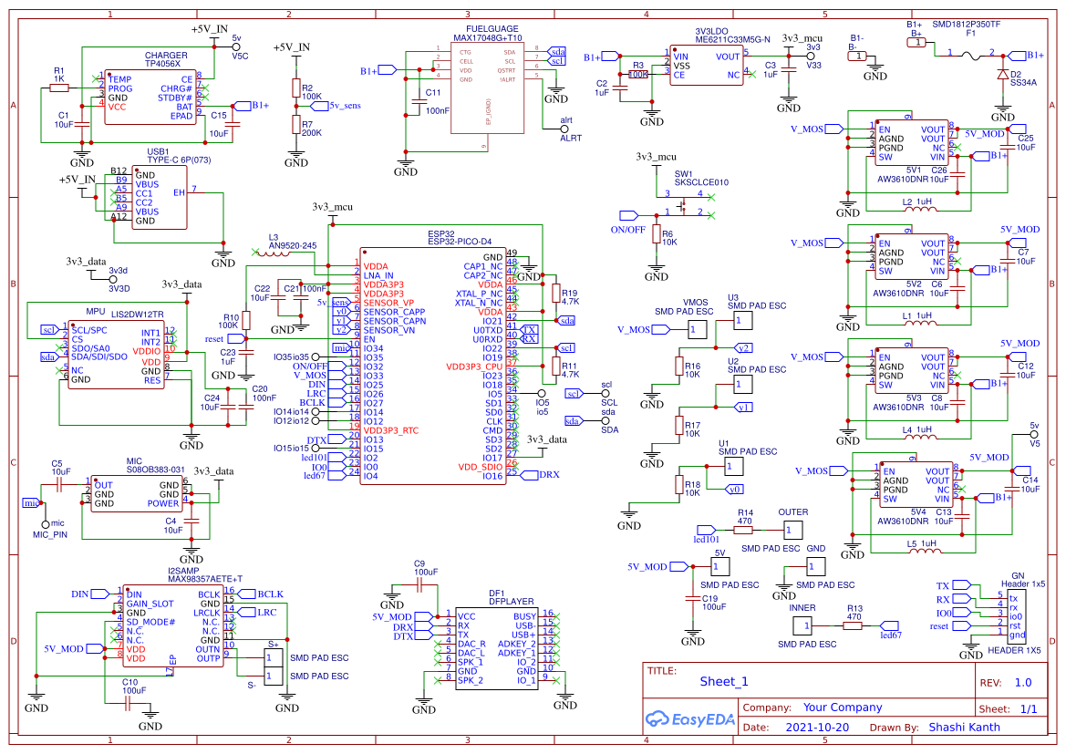
Opgave2

Slide 9
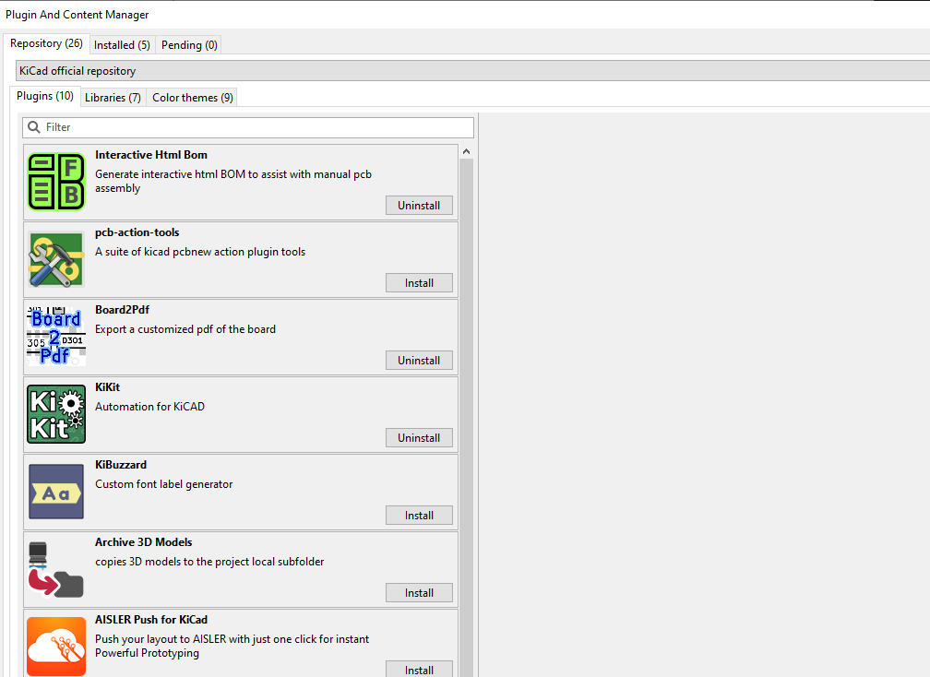
BOM
https://github.com/openscopeproject/InteractiveHtmlBom

Slide 10
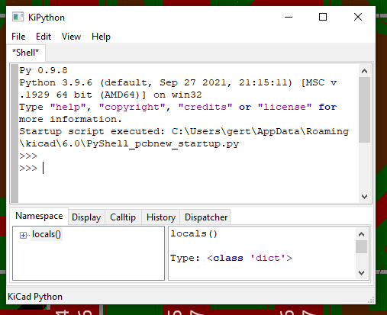
Panel
https://github.com/yaqwsx/KiKit

Slide 11


Tak
Gert Lauritsen
Gert@askob.dk

